Slide 1




Upgrade your INSPIRE data
to 5 star linked data
A best practices approach
Paul van Genuchten / INSPIRE Conference Aalborg June 2014 / CC-BY

Slide 2
INSPIRE meets Open Data
aka NeoGeography…

Slide 3
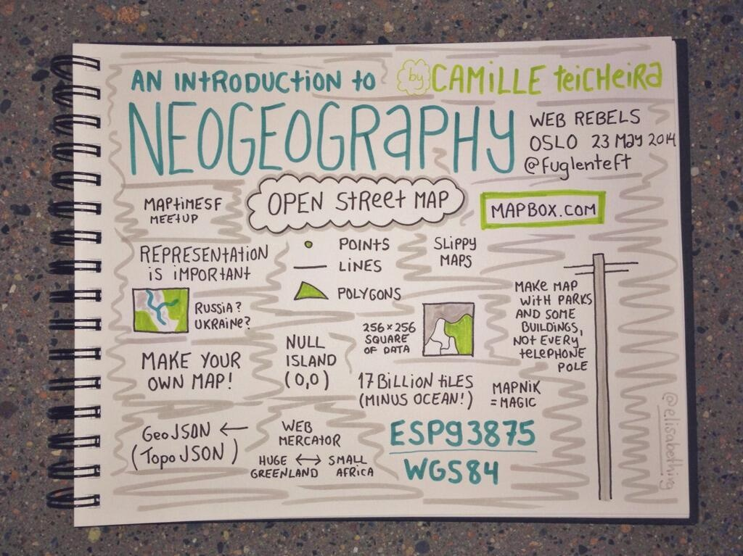

Slide 4


Slide 5
Does this relate to INSPIRE?

Slide 6
NO, not in any regulation
YES, INSPIRE recommends to publish as Open Data
YES, Open Data is a big potential audience
YES, Lot's of energy and innovation in the community
YES, joined efforts triple results

Slide 7
Is Open Data all that different?

Slide 8
YES
the API’s are Easy to Use
the User Interfaces are clean
Optimised for Performance
Based on community best practices

Slide 9
Is it really that different?

Slide 10
NO
Open Data also deals with
Data
Metadata
Projections
Tiles
Vectors
Vocabularies
(and we all use GDAL/OGR)

Slide 11
So it shouldn't be that difficult to connect?

Slide 12
... but it needs some attention
Some reparation work
Percieved complexity
Non involvement of community
Mutual unfamiliarity

Slide 13
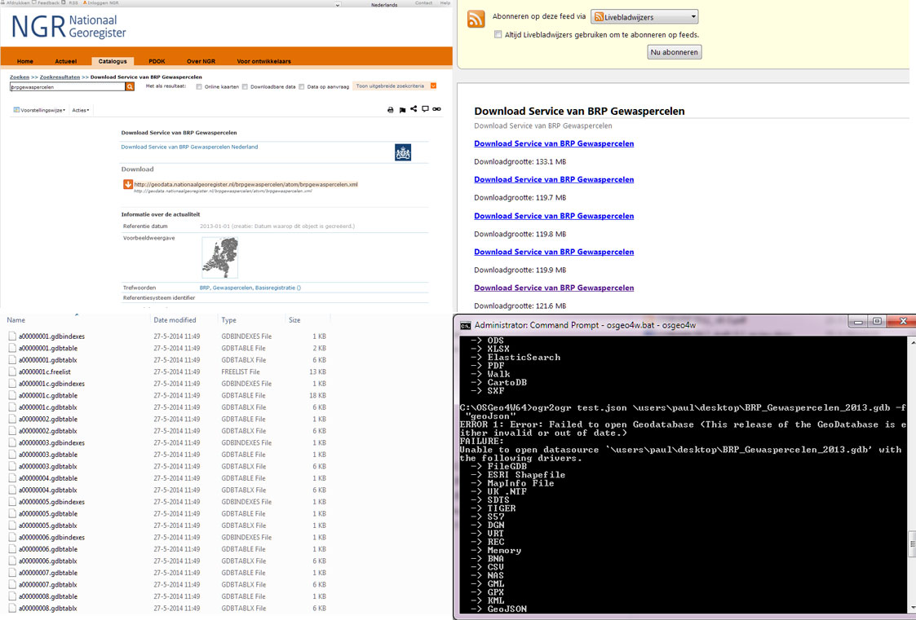

Slide 14
That is why we need ...

Slide 15
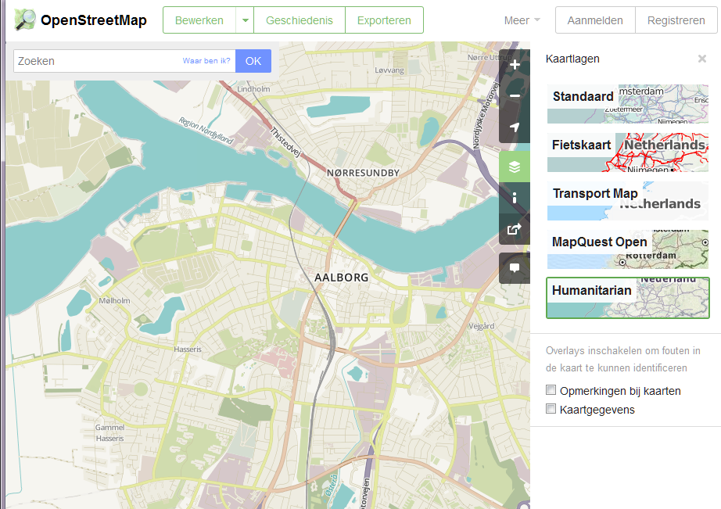

Slide 16
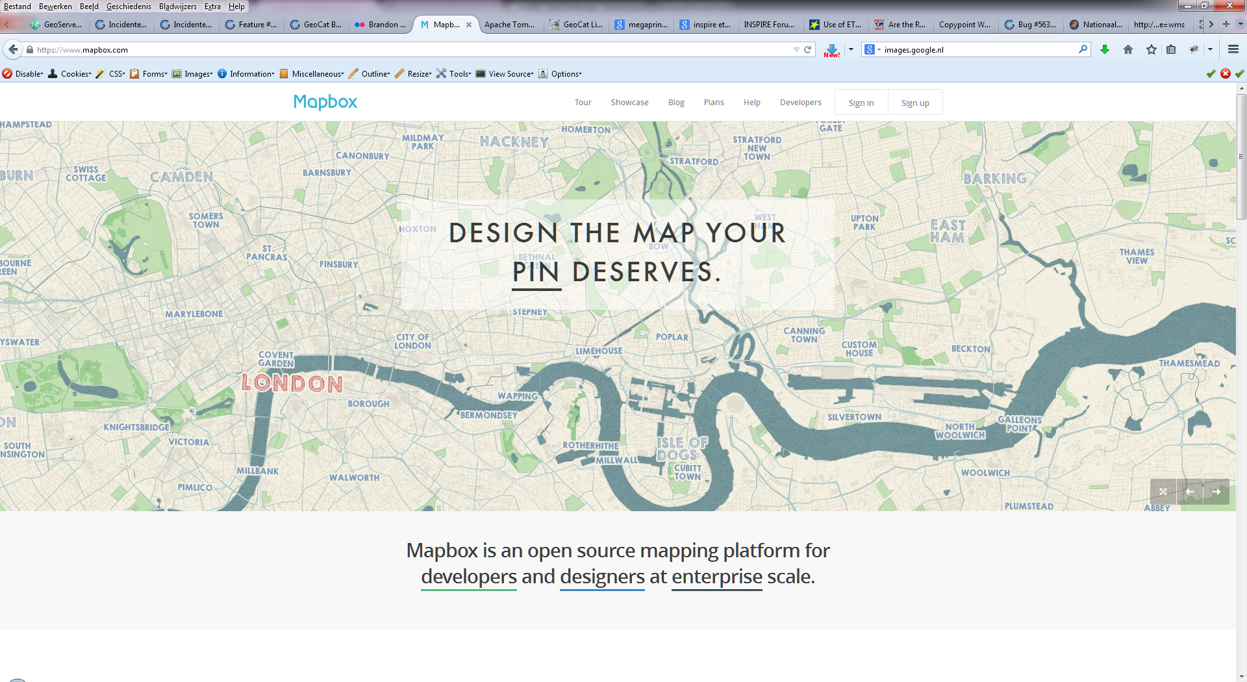

Slide 17
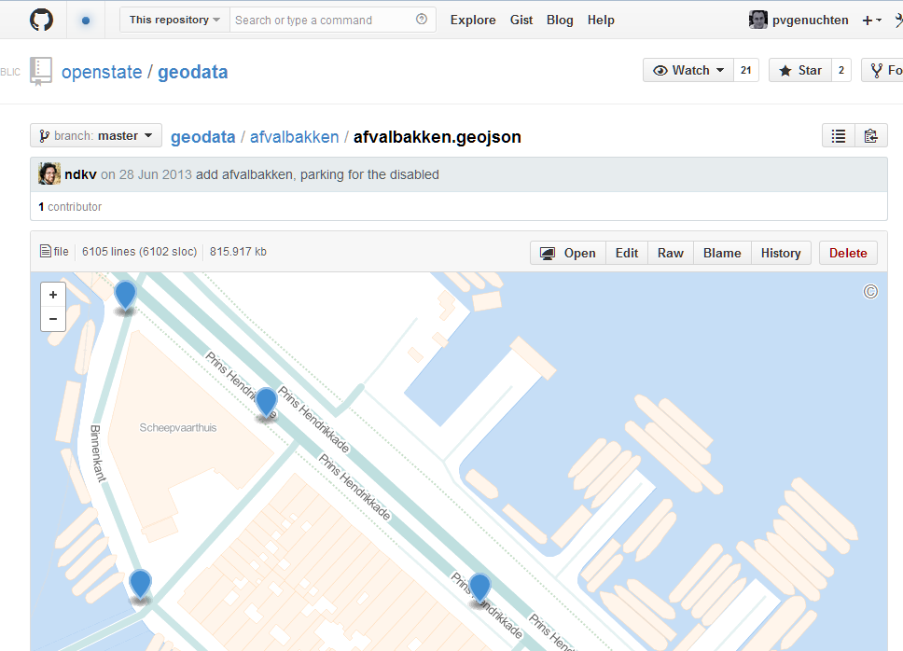

Slide 18
EPSG:3857

Slide 19
TMS vs WMTS
Vector-tiles

Slide 20
The players...
Data providers Should
Portal providers Could
Third parties Do
Communities Assist
Spec writers

Slide 21
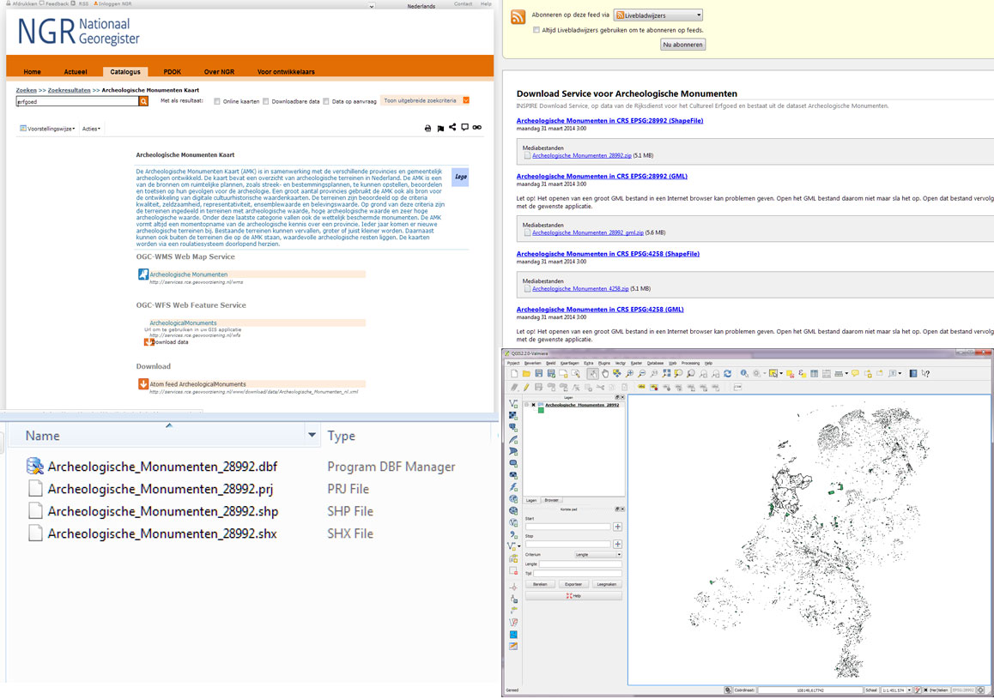

Slide 22
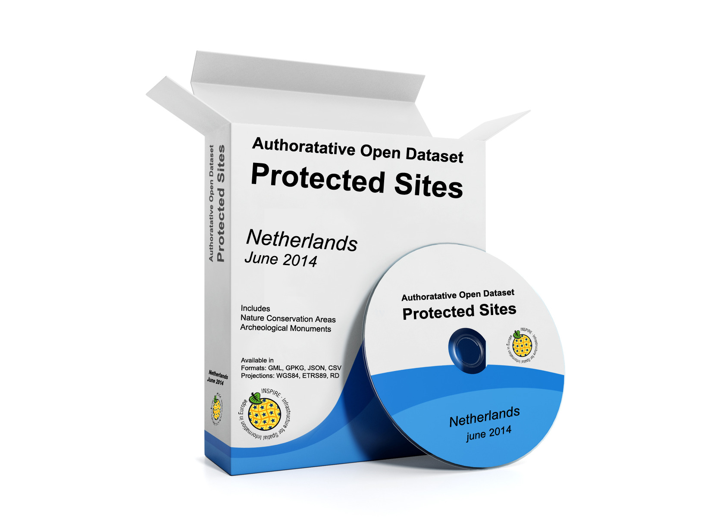

Slide 23
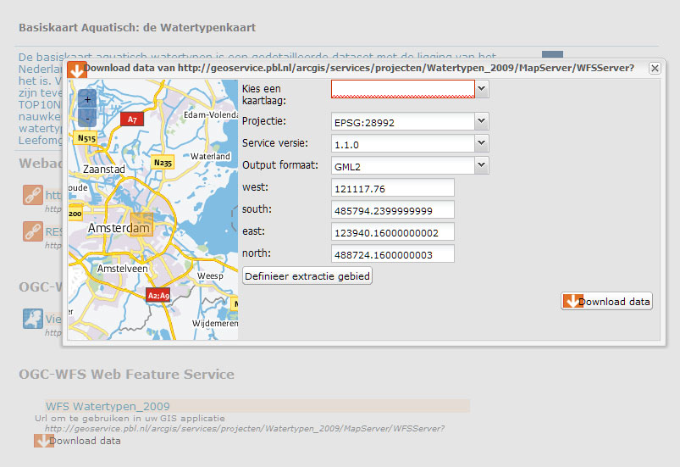

Slide 24
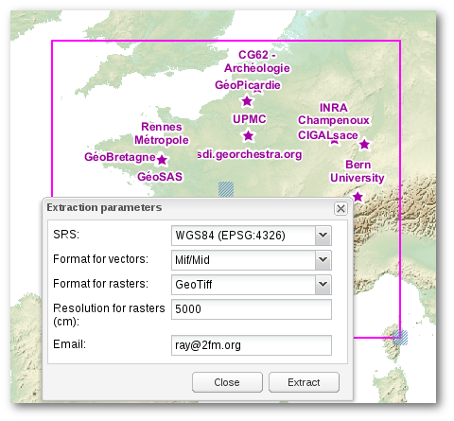
© geOrchestra

Slide 25
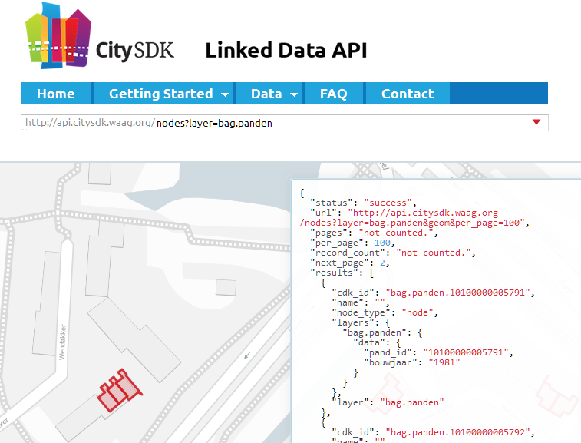

Slide 26
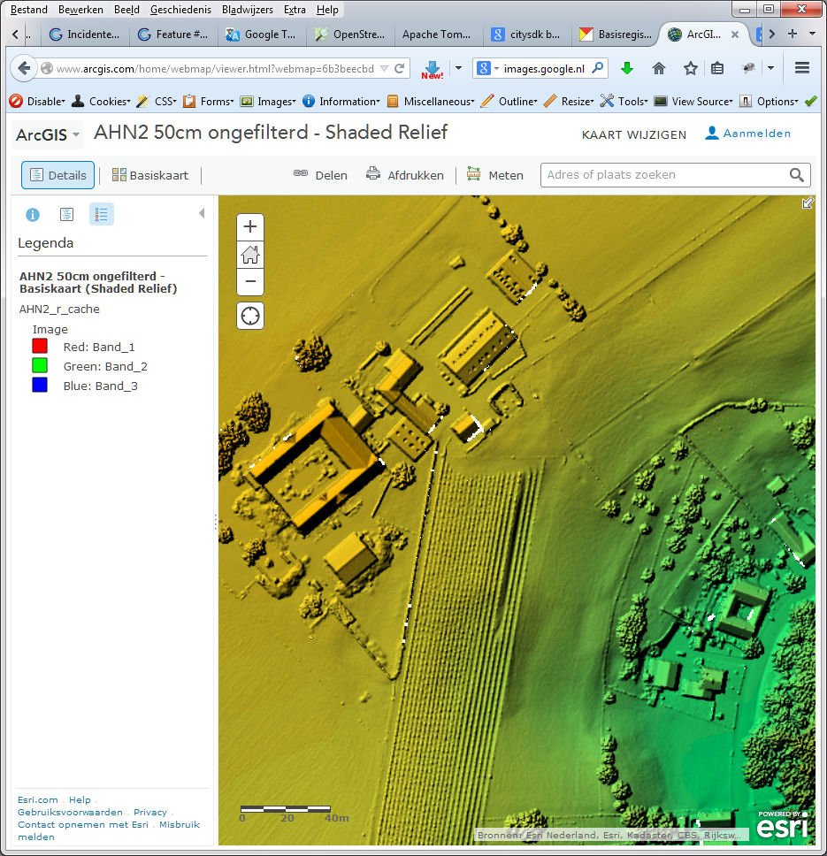

Slide 27
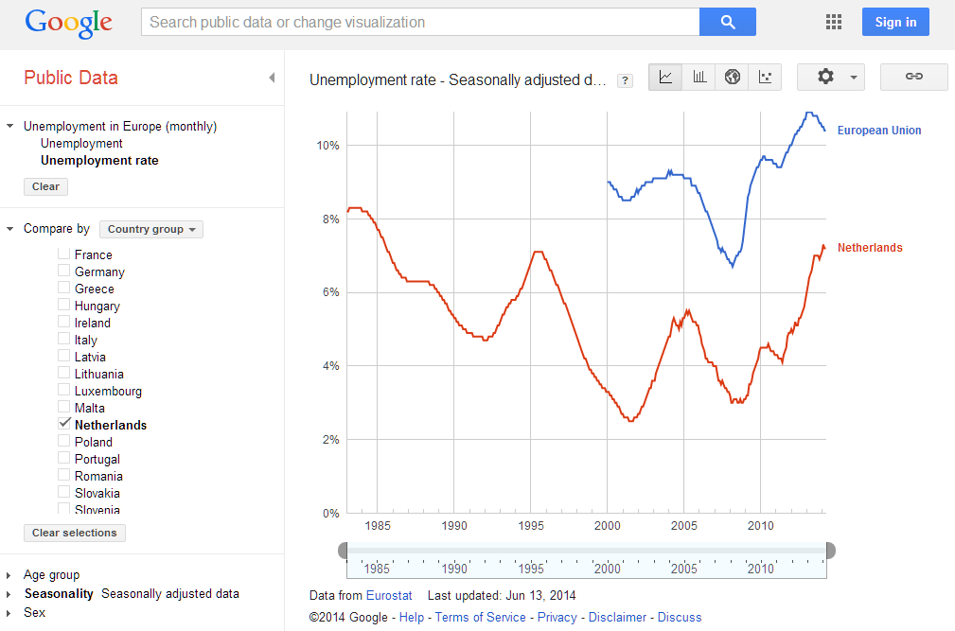

Slide 28
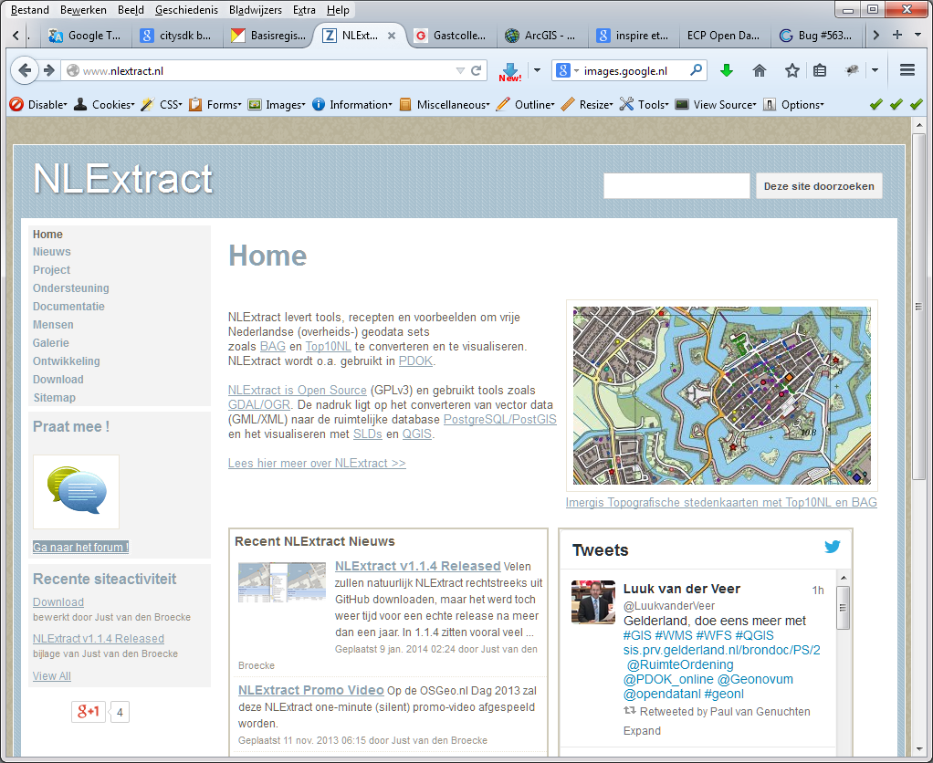

Slide 29
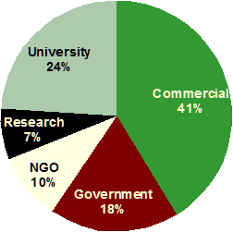
© Open Geospatial Consortium

Slide 30
Linked Open Data and INSPIRE

Slide 31

5 star Open Data
Select an Open License Publish as structured data Non-proprietary formats Use URI's to denote things Link the data to other data

Slide 32
INSPIRE and LOD share a goal
add universal semantics to data
paradigm is different

Slide 33
GML+iso19139+XSD+XSLT = RDF?
Not for as-is data

Slide 34
Alternative approach based on Open Data best practices
Work in progress based on work funded by Environment Canada, Agiv and COBWEB FP7

Slide 35
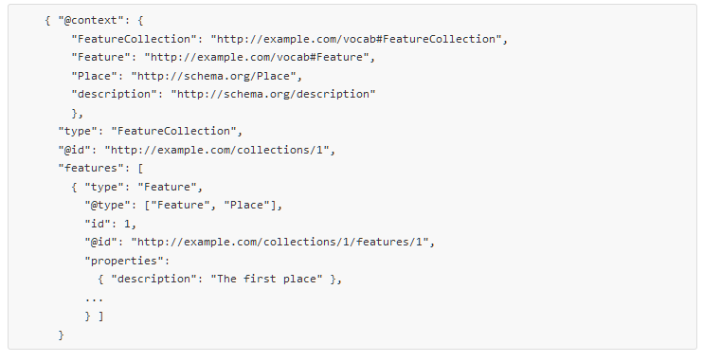
GeoJSON-LD
@sgillies http://github.com/geojson/geojson-ld

Slide 36
Web Accessible Folder
Files and WFS are duplicated as CSV and GeoJSON-ld in a WAF-tree (similar to Atom predefined)
WAF offers html representation of folder contents
WAF creation is triggered by metadata-modification-workflow in GeoNetwork

Slide 37
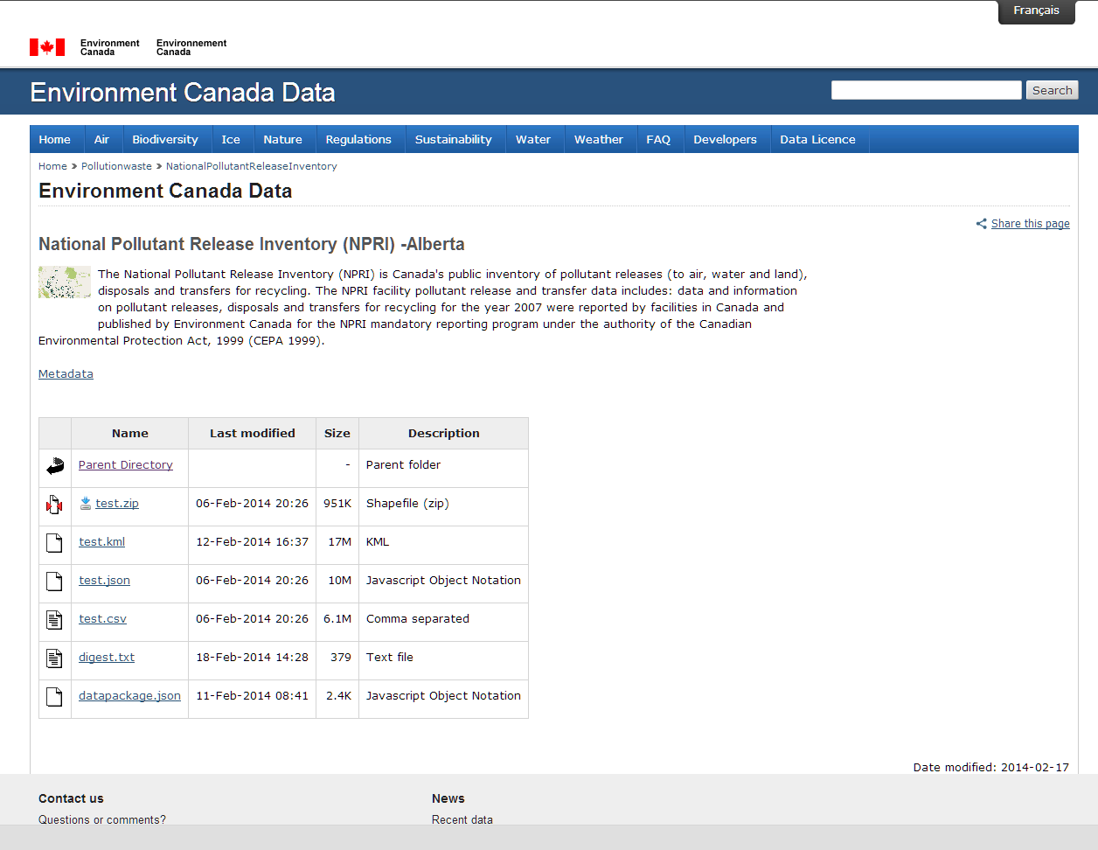

Slide 38
Datapackage.jsonld
Each folder gets an index-file linking files and folders based on skos:broader & skos:narrower
Based on datapackage.json specification from Open Knowledge Foundation (http://data.okfn.org/doc/data-package)
Package file links back to metadata in GeoNetwork

Slide 39
Semantics for Attributes
ISO19110 (feature-catalog metadata) editor in GeoNetwork enables definition of attribute semantics
Info to be used to create GeoJSON-ld
Should link to common vocabularies (INSPIRE registry)
Could be a first step in upcoming INSPIRE harmonisation efforts

Slide 40
Thanks for the attention
5 stars obtained
Resources
http://geocat.net http://data.okfn.org/doc/data-package
http://json-ld.org
http://cobwebproject.eu
http://5stardata.info
http://inspire.ec.europa.eu/registry
https://www.google.com/publicdata
http://bit.ly/1ur9wIO
http://wiki.apache.org/httpd/DirectoryListings
http://elisabethirgens.com http://geonetwork-opensource.org
http://data.gc.ca
http://osm.org
http://mapbox.com
http://toblerity.org/fiona
http://nationaalgeoregister.nl http://nlextract.nl
http://citysdk.waag.org/map
https://github.com/openstate/geodata

